Slide 1
Line Types
Unit 4

Slide 2

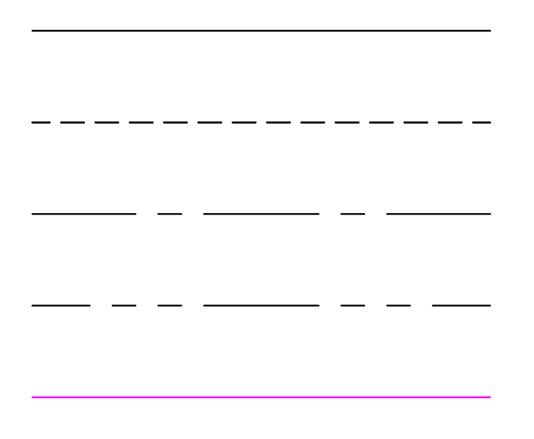
What are Line Types?
Different types of lines are used to convey information
Solid line - Indicates the edge of an object in the current view
Hidden line - Indicates an edge not visible in the current view
Centerline - Indicates the center of an opening or object
Phantom line - varies by application; can be a property line, or alternate location of moving part
Construction/Projection line – solid line used to align corresponding edges in another view
Notes:
Talking points:
If everything were the same line type it would be hard to convey elements at different heights or elements below are behind objects
Different line types are used to indicate upper cabinetry, elements to be demolished in a remodel, or hidden edges, like holes or openings, when designing parts. Can also indicate centerlines of openings, property lines on site plans, buried elements like gas, plumbing and electric
Construction lines/Projection lines are typically sketched very lightly to be erased later, or in AutoCAD they are drawn with a different color to avoid being confused with an actual edge of an object
There are many different line types but these are few of the more commonly used

Slide 3
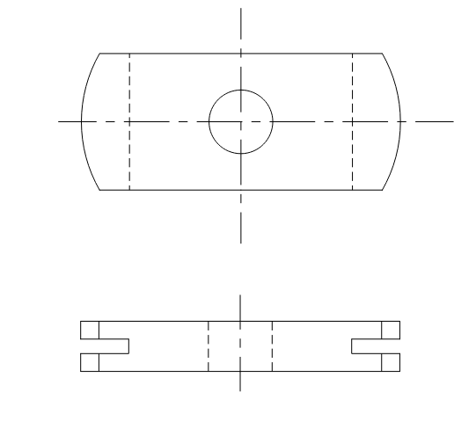
MECHANICAL EXAMPLE
TOP VIEW
FRONT VIEW
Drawing from Up & Running with AutoCAD, Gindis & Kaebisch
Notes:
Mechanical drawings show centerlines of holes
From the top view we see hidden lines indicating the slots on the sides
From the front view we see hidden lines indicating the center hole

Slide 4
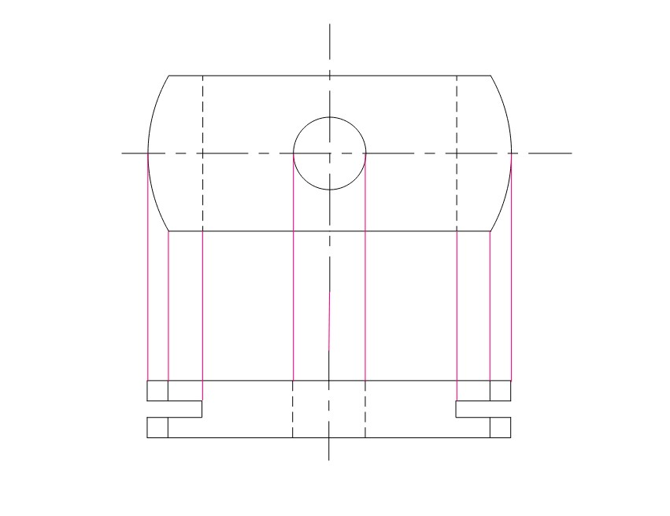
TOP VIEW
FRONT VIEW
Drawing from Up & Running with AutoCAD, Gindis & Kaebisch
Notes:
Mechanical drawings show centerlines of holes
From the top view we see hidden lines indicating the slots on the sides
From the front view we see hidden lines indicating the center hole
Construction/Projection lines are used to align (project) edges from one view to the next – edges of part (notice curved edge), edge of slot (becomes hidden line in Top view), edges of hole (hidden lines in Front View), center of hole

Slide 5
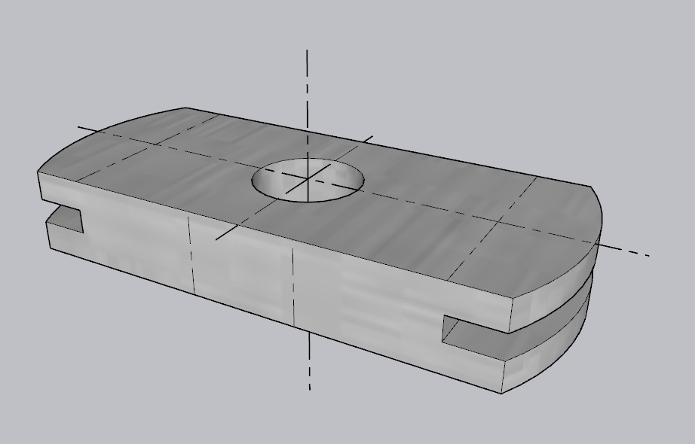
Notes:
Mechanical drawings show centerlines of holes
From the top view we see hidden lines indicating the slots on the sides
From the side view we see hidden lines indicating the center hole
In the 3d view we wouldn’t show the hidden line and centerlines, that is just for example

Slide 6
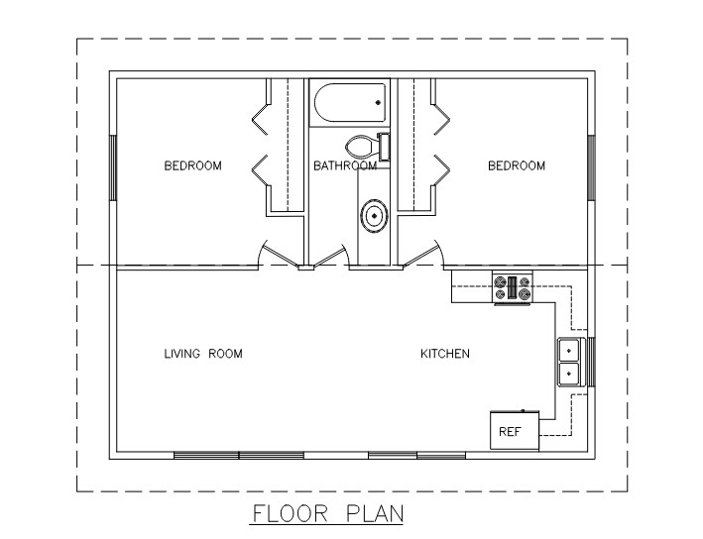
FLOOR PLAN EXAMPLE
Notes:
Solid lines indicate the edge of objects, whether it’s a wall, cabinet, window, or door. Notice hidden lines for upper cabinets in kitchen, upper shelf in closets. Anything above 4’-0” on a floor plan is shown dashed, with hidden line type. Different scale line type for hidden lines indicating roof edges and center of roof

Slide 7
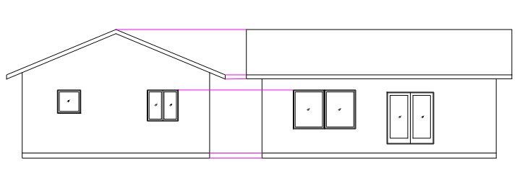
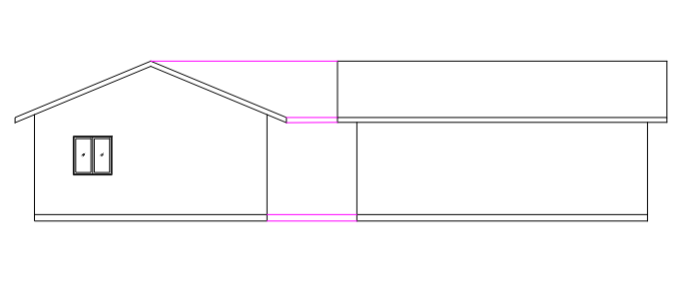
HOUSE ELEVATION EXAMPLE
SIDE ELEVATION
FRONT ELEVATION
SIDE ELEVATION
BACK ELEVATION
Notes:
Magenta solid line used to line up or project the edge of one object to another view.
For example – for clarity and to reduce errors by not redrawing edges, we can project the bottom of the house over for the start of the next elevation view. Then we can project the roof height over to the next elevation because the roof will be the same height in that view as well. The windows will also be at the same height from one side of the house to the other in this case, so we can project that height over to the next elevation.

Slide 8
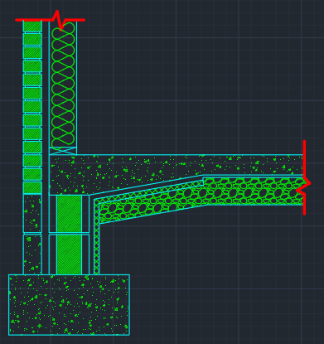
WALL SECTION EXAMPLE
Drawing from Up & Running with AutoCAD,Gindis & Kaebisch
Notes:
Red heavy lines with a zigzag are a breakline and tell us the objects continue beyond the breakline. This is used to save space on a drawing.
The squiggly line indicates batt insulation in a wall. This is also a specific line type.
Notice the different patterns, called Hatch Patterns. These help tell us what material is being used. Concrete has small dots and triangles. Gravel backfill looks like small rocks. Brick is the diagonal pattern.

Slide 9
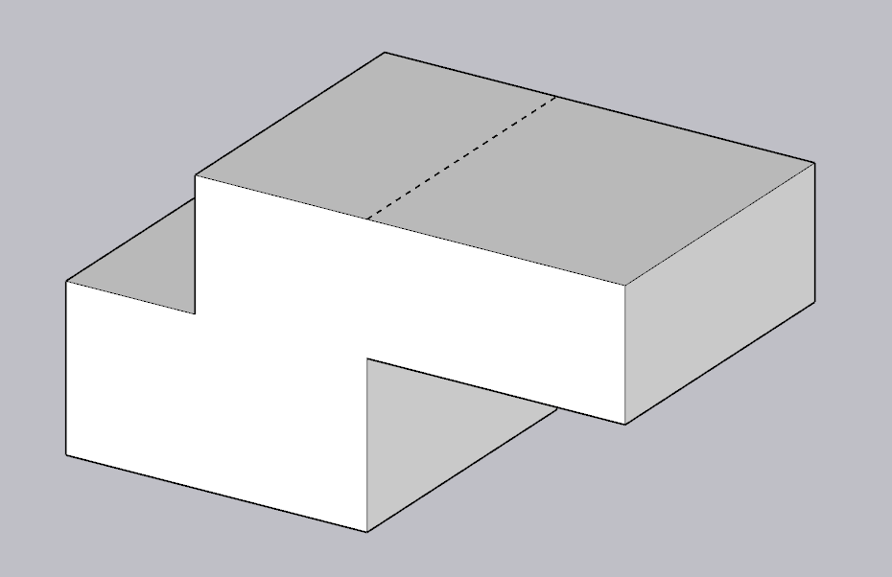
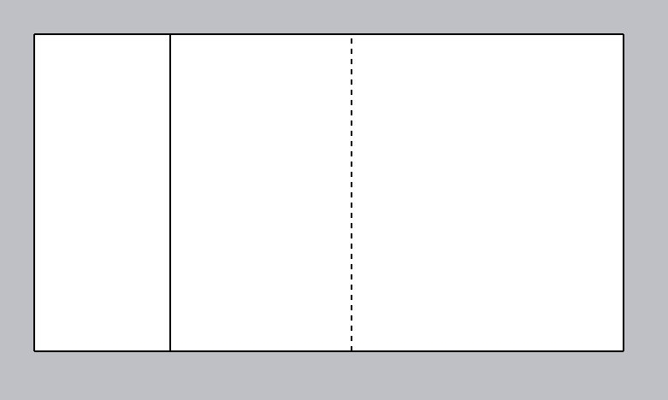
Notes:
The Hidden line on the Top View indicates the hidden edge below
The Solid line on the Top View indicates the left edge of the top
In the 3d view we wouldn’t show the hidden line, that is just for example

Slide 10
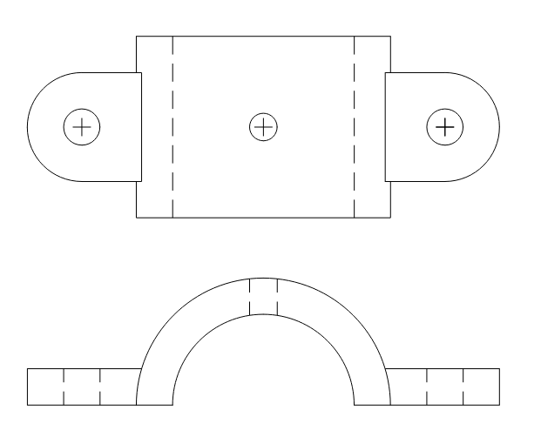
TOP VIEW
FRONT VIEW
Drawing from Up & Running with AutoCAD, Gindis & Kaebisch
Notes:
In this example, on the Top View we see center marks for the center of the holes and hidden lines, indicating the edges of the piece on the bottom. On the Front View, hidden lines indicate where the holes are.

Slide 11
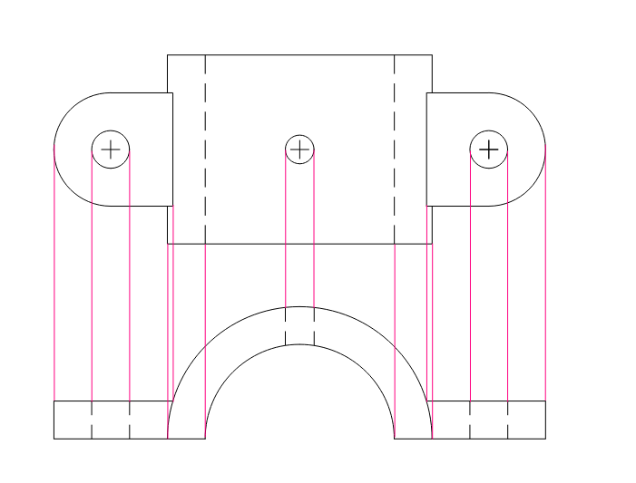
TOP VIEW
FRONT VIEW
Drawing from Up & Running with AutoCAD, Gindis & Kaebisch
Notes:
In this example, on the Top View we see center marks for the center of the holes and hidden lines, indicating the edges of the piece on the bottom. On the Front View, hidden lines indicate where the holes are.
Construction/Projection lines are used to align (project) edges from one view to the next – edges of overall part width, edges of holes (hidden lines in Front View), edges of where side tab meets curved portion of part (creates a new edge on the top view which helps us understand the part is curved)

Slide 12
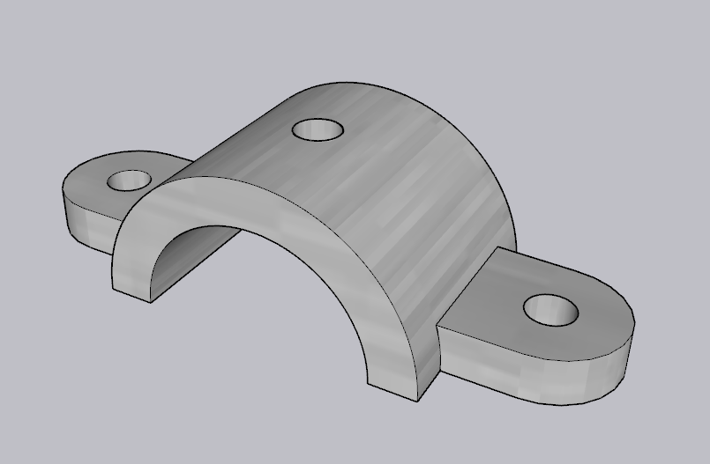
Notes:
In this example, on the Top View we see center marks for the center of the holes and hidden lines, indicating the edges of the piece on the bottom. On the Side View, hidden lines indicate where the holes are.

Slide 13
Review
What line type indicates an edge not visible in the current view?
A) Phantom
B) Hidden
C) Solid
D) Centerline
E) Construction/Projection Line

Slide 14
Review
What line type indicates an edge not visible in the current view?
A) Phantom
B) Hidden
C) Solid
D) Centerline
E) Construction/Projection Line

Slide 15
Review
What line type indicates the edge of an object in the current view?
A) Phantom
B) Hidden
C) Solid
D) Centerline
E) Construction/Projection Line

Slide 16
Review
What line type indicates the edge of an object in the current view?
A) Phantom
B) Hidden
C) Solid
D) Centerline
E) Construction/Projection Line

Slide 17
Review
What line type is a solid line used to align corresponding edges in another view?
A) Phantom
B) Hidden
C) Solid
D) Centerline
E) Construction/Projection Line

Slide 18
Review
What line type is a solid line used to align corresponding edges in another view?
A) Phantom
B) Hidden
C) Solid
D) Centerline
E) Construction/Projection Line

Slide 19
Review
What line type indicates the center of an opening or object?
A) Phantom
B) Hidden
C) Solid
D) Centerline
E) Construction/Projection Line

Slide 20
Review
What line type indicates the center of an opening or object?
A) Phantom
B) Hidden
C) Solid
D) Centerline
E) Construction/Projection Line

Slide 21
Review
What line type varies by application; can be a property line, or alternate location of moving part?
A) Phantom
B) Hidden
C) Solid
D) Centerline
E) Construction/Projection Line

Slide 22
Review
What line type varies by application; can be a property line, or alternate location of moving part?
A) Phantom
B) Hidden
C) Solid
D) Centerline
E) Construction/Projection Line

